Slide 1

Lernfeld IT Englisch
IT Milestones Chapter 10

Slide 2
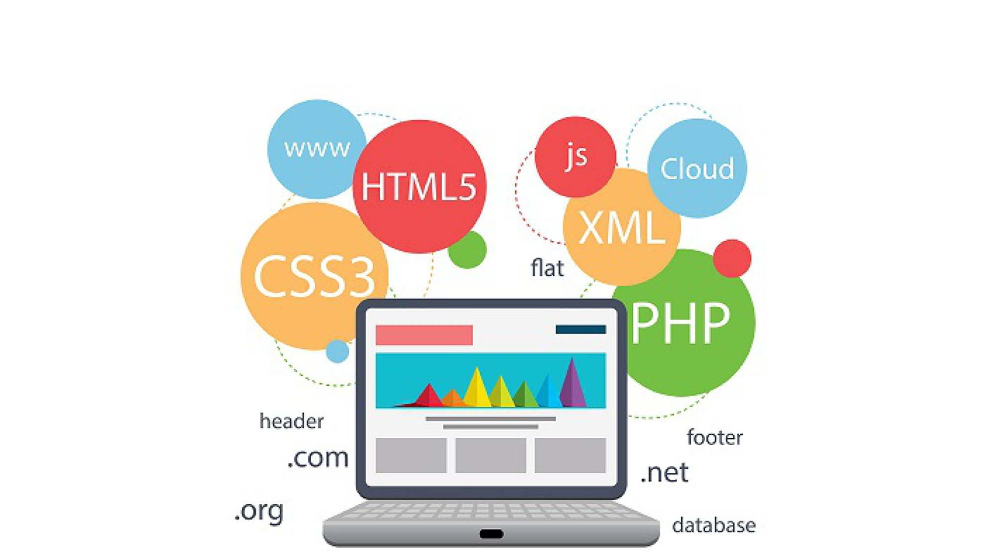
IT Milestones Chapter 10
Chapter 10:
pages 76 – 79
-Web-based application software
-Computer health maintenance
-Data backup methods and data recovery

Slide 3


IT Milestones Chapter 10
Tools and applications
page 76
Exercise 1: which tools and applications were most likely used?
Exercise 3: Match the types of application software to the definitions.

Slide 4

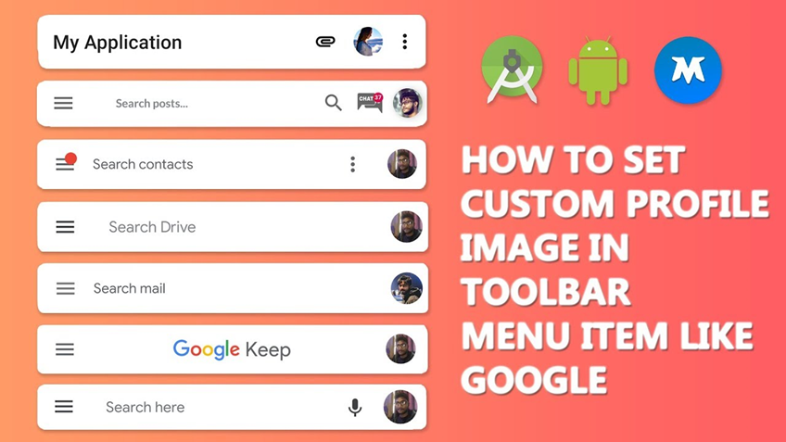
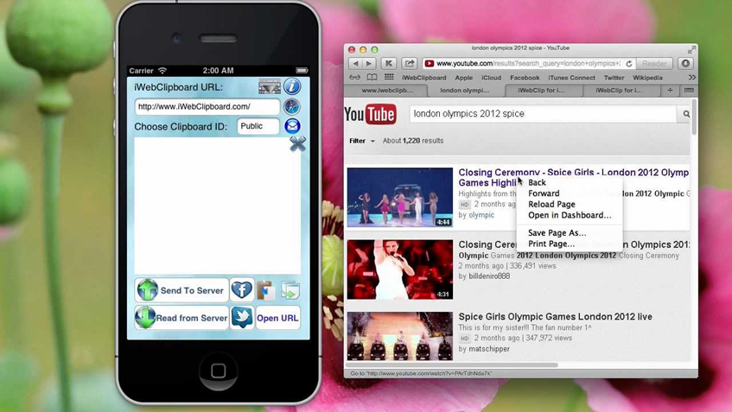
IT Milestones Chapter 10
Web-based application
page 77
Exercise Nr. 4 step-by-step instructions for two separate word pasting functions...list the instructions in correct sequences =)
.

Slide 5


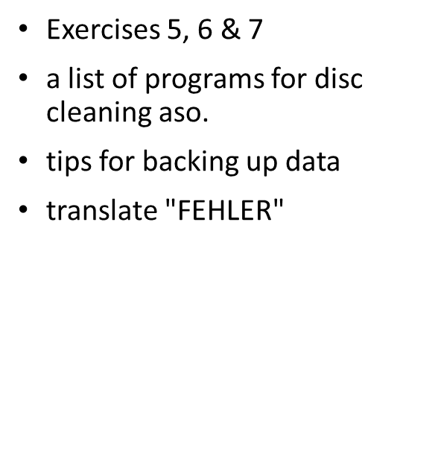

IT Milestones Chapter 10
Computer health maintenance
page 78

Slide 6
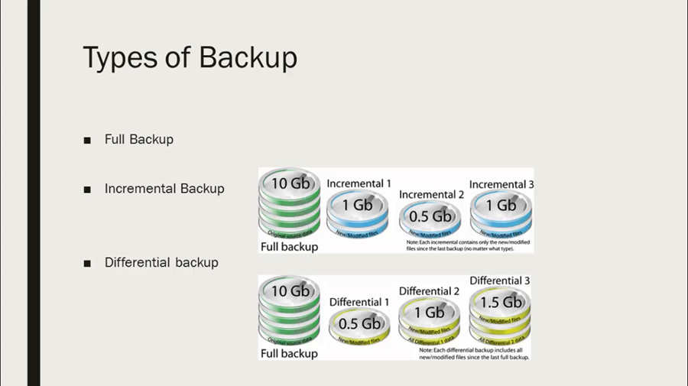
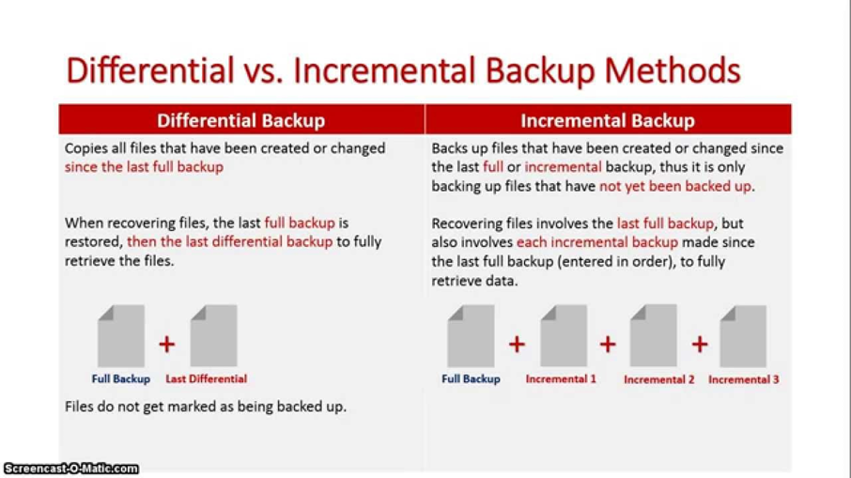
IT Milestones Chapter 10
Data backup methods and data recovery page 78
Exercise Nr. 1: Advantages and Disadvantages
Vor- und Nachteile der Datensicherungsmethoden

